Slide 1
Office 365 development
Office add-ins best practices and guidelines Marketing and GTM
Dean Slawson

Slide 2
Add-in best practices
https://msdn.microsoft.com/EN-US/library/office/mt590883.aspx
Functional & UX design
Design for deep value
First run
Sign-in
Add-in commands
UX quality
Performance
Marketing,
GTM
Store listing
Marketing
Website
Serving
Monitor
User voice & reviews
Update regularly
Post-launch
Learning
Selling

Slide 3
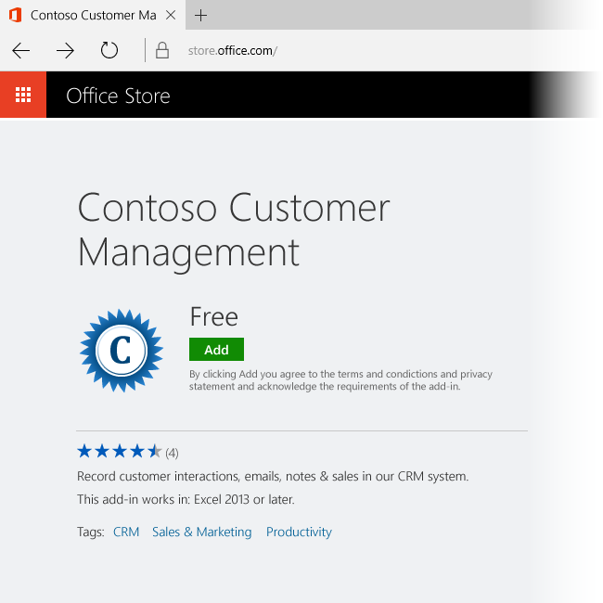

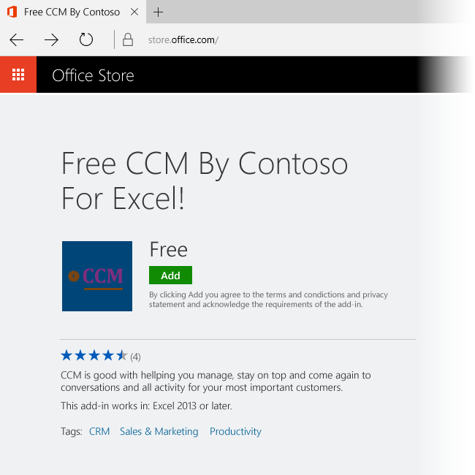
Your listing in the Office Store
Add-in name, description, and logo guidelines
Use informative titles and short descriptions
Avoid redundant language
Include differentiating keyword tags
See “Create effective Office Store apps and add-ins” https://msdn.microsoft.com/en-us/library/jj635874
Logo tips
Create a descriptive identity that’s evocative of your brand or the value of your add-in
Avoid overly busy or hard to read icons
Check for potential trademark infringement
Follow size guidelines
DO
DON’T
Notes:
The information and images you submit to the Seller Dashboard with your app or add-in becomes the Office Store listing for it. This information is the first thing prospective users see, and creates their first impression. Make sure that the information you submit — including your title, description, logos, and screenshots — clearly communicates the benefits and functionality that your solution provides.
Apply the following when you create your title, description, and images:
Describe what your solution can do for customers. Answer the question: What problem does this app solve?
Use unique logos for each app or add-in.
Include screenshots that show off your UI. Be sure to remove any personal information from your screenshots.
If you update your functionality, update your description too.
Use a customer-friendly voice. Be concise and use natural language.
Avoid marketing speak and buzz words.
Check the spelling and grammar on your titles and descriptions.

Slide 4
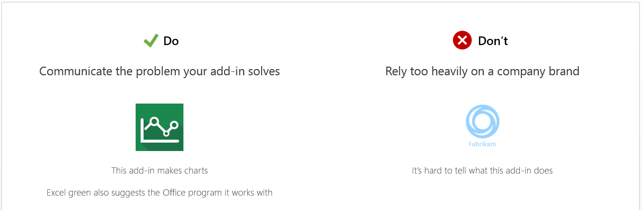
Create a consistent visual identity (logo)
Communicate the problem your add-in solves
This add-in makes charts. Excel green also suggests the Office program it works with
DO
Rely too heavily on a company brand
It’s hard to tell what this add-in does
DON’T
Notes:
Your name and description can be powerful tools to draw in potential customers. You also want to present a unified visual identity for your app or add-in. The logo you use is important. Two files represent your logo. To present a consistent logo, both images should be of the same logo or icon. This way, the user sees the same logo in the Office Store and when the add-in is displayed in Office or SharePoint. The two images have different formatting requirements.
Your logo should:
Convey how your add-in helps the customer get work done.
Use simple imagery. Don't clutter or complicate your image.
Communicate the problem that the add-in solves. Don't rely on your company logo for your image.
Be 96 x 96 pixels, and less than 250 KBs.

Slide 5
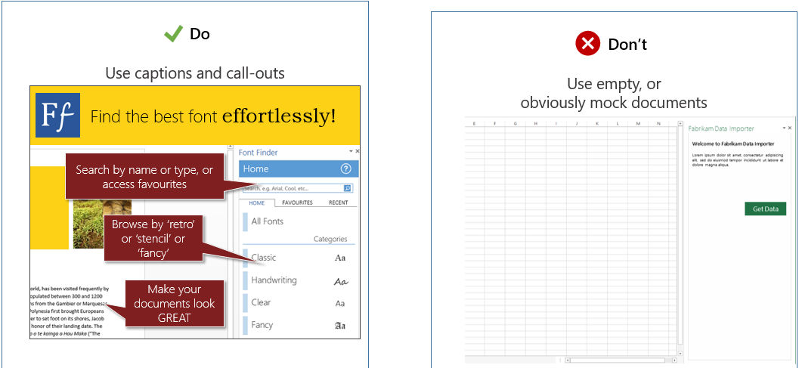
DO
Use captions and call-outs
Effective screenshots
DON’T
Use empty, or obviously mock documents
Notes:
Make your screenshots rich and informative. Help customers understand how your add-in solves problems and helps them get work done more effectively. In your screenshots:
Focus on your add-in. Don't show large areas of empty screen.
Show real content rather than an empty document.
Use captions and callouts to clarify features.

Slide 6
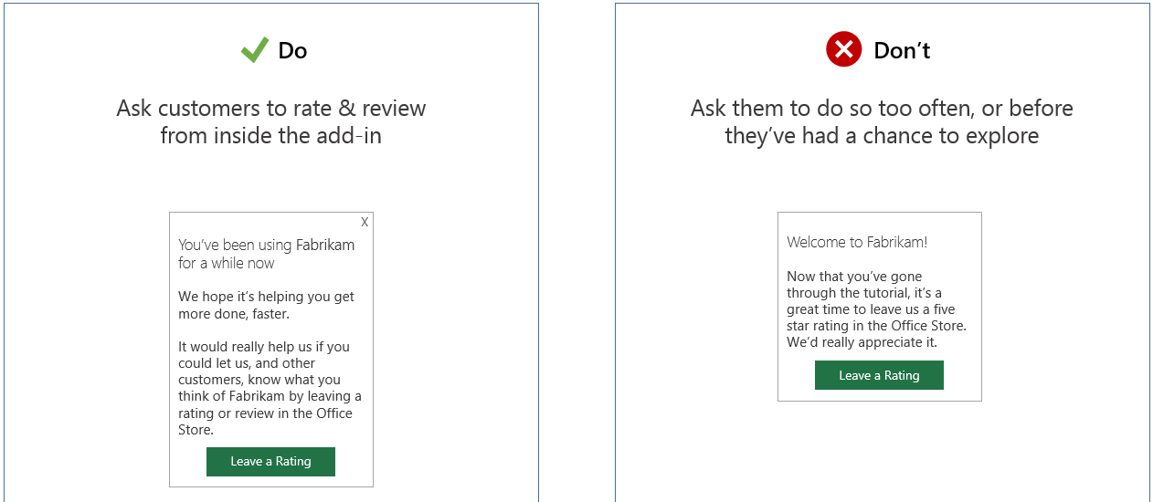
DO
Ask customers to rate and review from inside the add-in
Ask for user ratings and reviews
DON’T
Ask them to do so too often, or before they’ve had a chance to explore
Notes:
Good ratings and reviews lead to better store placement and improved customer perception of your product. Customers also use reviews as a forum to offer feedback and suggestions, particularly if feedback and support options are not available within the app or add-in. Be sure to:
Ask customers to rate and review from within your add-in. Make sure that they've had a chance to explore the add-in first, and don't ask for feedback too often.
Offer help and support from within your add-in, so customers don't have to leave feedback in Office Store reviews.

Slide 7
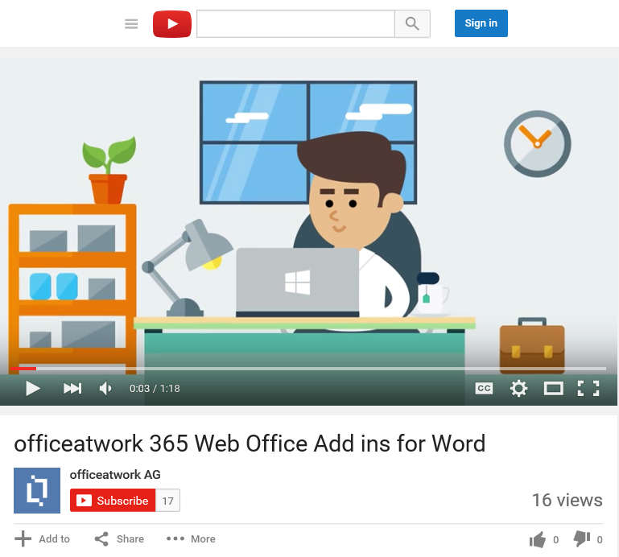
Website and marketing: What you can do
Create and promote a dedicated website for your add-in. This is an important conduit to the Store to increase downloads
Promotional videos can also help drive traffic
Tip: Ensure your add-in’s website and any posted content have great SEO so that users can find them through web search (e.g., keywords include company and add-in name, in full and in part)

Slide 8
Website and marketing: What you can do
Create and promote a robust trial experience of your add-in
Add videos, screenshots, and in-product training and tips to your add-in to show users the value and how it works
Reminder: users are still deciding if they will use/continue to use your add-in even after they’ve downloaded it

Slide 9
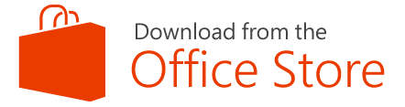
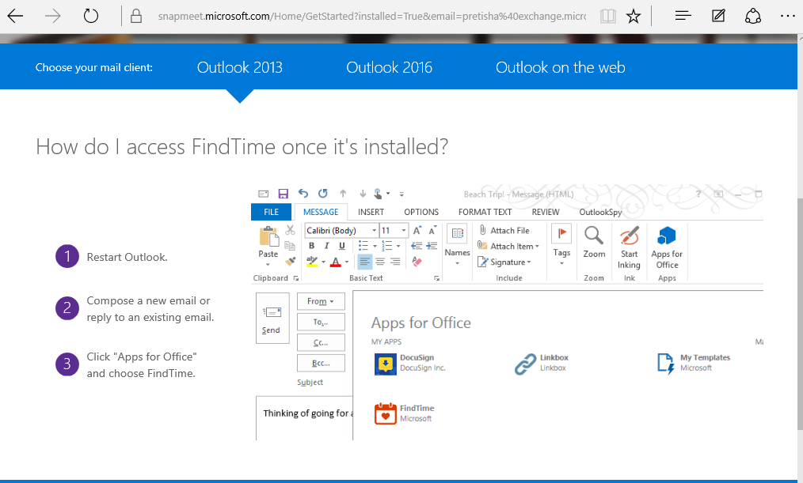
Website and marketing: What you can do
Promote the add-in on your home page and other prominent places
Tip: Use our download badges on your site
Tip: Show users how to find and access your add-in
Send marketing email with awesome screenshots to increase awareness and downloads
Tip: Pop an HTML form to capture user email and profile info and push into an outbound email engine
Retain
Use captured emails to run scheduled outbound communications around promotions, new features, requests for feedback, trial extensions, upsell efforts, etc.
Notes:
Use our Best Practices App code to capture user email addresses, prompt reviews, solicit feedback, tease Paid features, show videos, and pump email addresses into an outbound email campaign engine during the Trial
Add videos and in-product training and tips

Slide 10
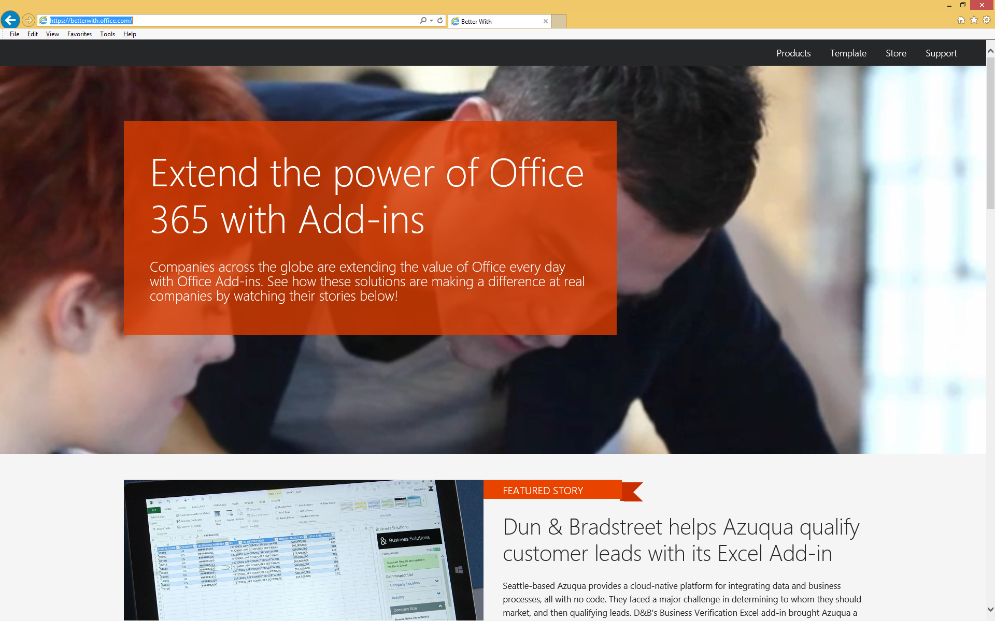
Website & marketing: How Microsoft can help
Promotions for high quality, high value add-ins
Channel 9 and dev.office.com promotional videos
http://Betterwith.Office.com (customer evidence videos)
Office Add-In of the Week (product reviews and demos)
Add-ins used in Hero Demos, EBC, Sales decks
Store merchandizing programs (e.g., temporary listing boost)
Top rated add-ins get mentioned in the developer newsletter
Potential for opportunities to get you in front of customers at conferences if you join our developer program and are willing to build Beta versions for shows like Connect and Build
Check out the //Build presentation by Jim Epes “Making Money with Office 365” for great ideas on promoting your add-in!

Slide 11
Getting ready for the Office Store
Think of a great add-in name!
Highlight value propositions clearly and concisely
Update your add-in description
Provide quality screenshots or photos of add-in
Include a video
Know the store validation criteria https://msdn.microsoft.com/EN-US/library/jj220035.aspx
Provide a privacy statement and terms & conditions. Be very clear what you do with any personally identifiable information
Localize for your target markets
List in Office Stores for countries/regions you support (more the better!)
Schedule your add-in release to coincide with your press releases/blog announce
Notes:
https://msdn.microsoft.com/EN-US/library/jj220035.aspx

Slide 12
Thank you

